Slide 1
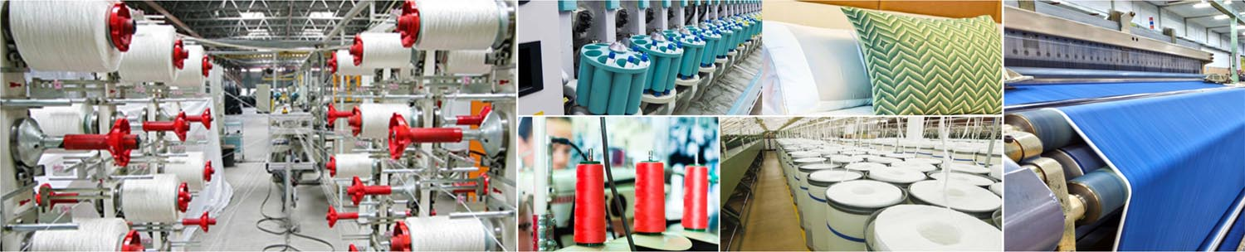
Textiles Solution Footprint
Snehashis Goswami, 24th Jan 2017

Slide 2


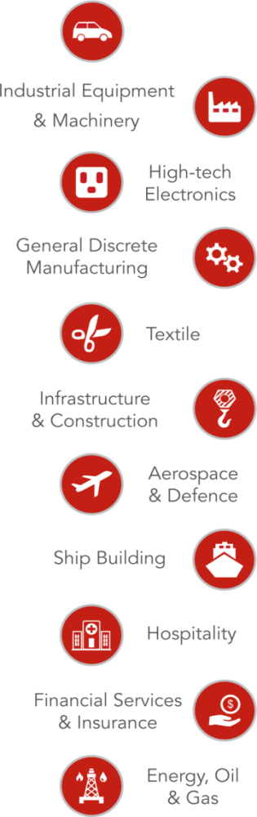

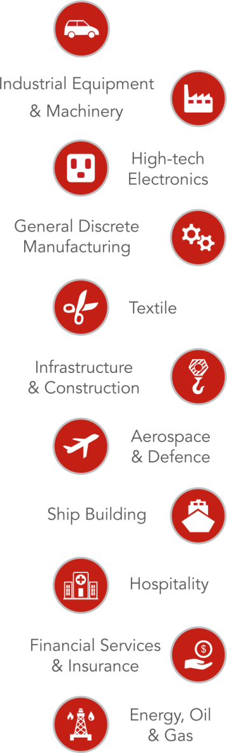


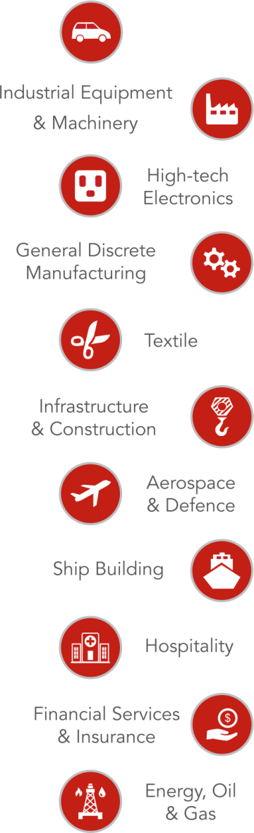


Executive Summary
Merino Services – Partner 2 Progress
US$250+
Million Merino Group
300+
Happy Customers
250+
Domain Experts
40+
Project Countries
7+ Offices
24x7
AMS
9001: 2008
Certified
Proven Methodology
Infor Gold Level Partnership
12+ Years of Infor Experience
Industry Focus
Industrial Equipment & Machinery
High-tech Electronics
Aerospace &
Defense
General Discrete Manufacturing
Financial Services & Insurance
Retail &
e-Commerce
Food & Beverages
Automotive
Textile
Textile
Notes:
T

Slide 3






Services Offering
Application Managed Services
Hosted Services
Web Development /
Portal / POS Development
Education & Training
On Demand” Service & Support
Migration / Upgrade Projects
ERP Readiness and Health Checks
Implementation and Consulting Services

Slide 4


Global Presence
Merino Services Ltd.
Merino Consulting Services
Merino Consulting Services B.V.
Merino Consulting Services Inc.
Merino Consulting Services Pte. Ltd.
Merino Consulting Services
Merino Consulting Services SDN BHD
USA
THE NETHERLANDS
UAE
INDIA
MALAYSIA
SINGAPORE
HONGKONG

Slide 5
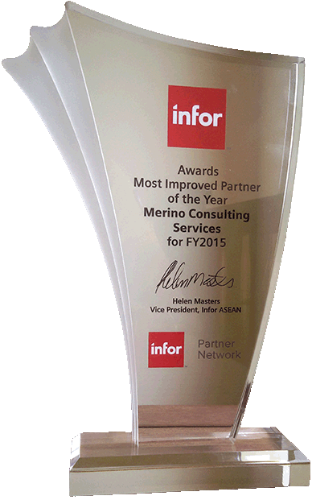
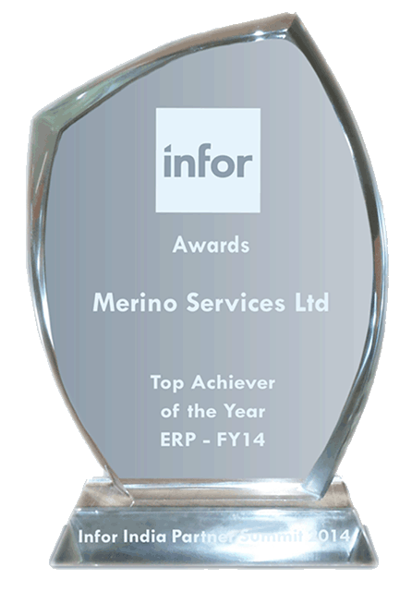
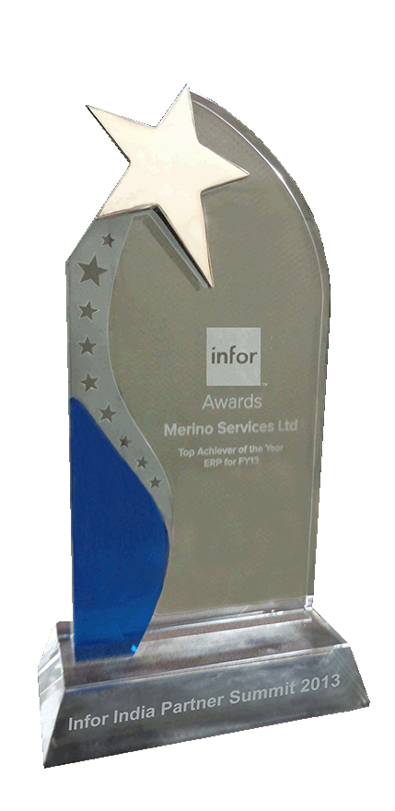
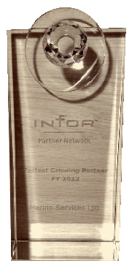




Achievements
Most Promising Partner ASEAN 2015 by Infor
Top Achiever Award
2014 by Infor
Top Achiever Award
2013 by Infor
Fastest Growing Partner Award 2012 by Infor
2015
2013
2014
2012

Slide 6








Technology Alliances and Enterprise Application

Slide 7
About Solution
Notes:
Hence, Infor 10x is not another traditional ERP system.

Slide 8
About Solution
Merino believes in “Specialized by Industry” solution
The focus area of Merino remains to those Micro Verticals, where either no solution is available or the TCO of the solution is very high
Textile is one of those focussed Vertical with following Micro verticals
Spinning
Weaving (Fabric)
Weaving (Terry Towel)
Knitting
The solution is developed on Infor ERP LN Platform
The development strategy does not restrict any future update of ERP LN
Infor ION (an agile Middleware) enables the solution to be integrated with any other application
Dyeing & Finishing (Yarn & Fabric)
FIBC
Technical Textiles
Made Ups

Slide 9
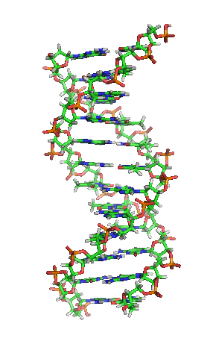
DNA of the Solution
Product Specification Design (Sort Master)
Barcode
Sales & Operation Planning
Subcontracting
Production Planning
Multi Site Planning
Mixed Mode Manufacturing
Recipe Management
Formula Management
Lot / Batch Traceability
Product Costing
Document Management
Multi Currency
Alerts and Workflows - Manage by Exception

Slide 10
Solution Coverage

Slide 11
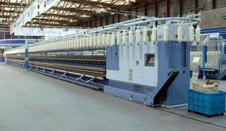
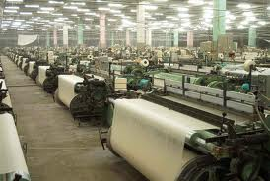
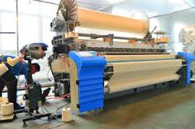
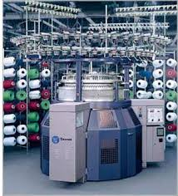
Solution Coverage
Ring Spinning, Open End Spinning
Fabric
Terry Towel
Knitting

Slide 12
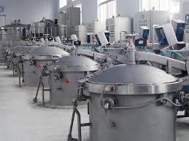
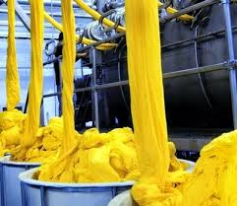
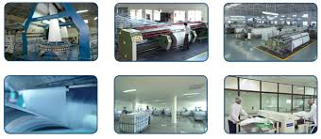
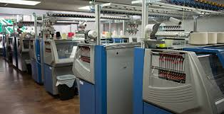
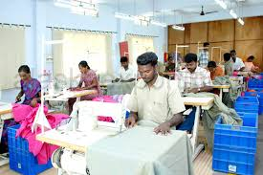
Solution Coverage
Dyeing & Finishing
FIBC
Technical Textiles
Made Ups

Slide 13













Overall Architecture
Design
Spinning
Dyeing
Winding
Weaving
Knitting
Finishing
Forecast
Planning
Production
Sales
Quality
Packing
Subcontracting
Purchase
Warehouse
Service
Finance
Textiles Solution
ION Middle Ware
Process
Experience
Intelligence

Slide 14
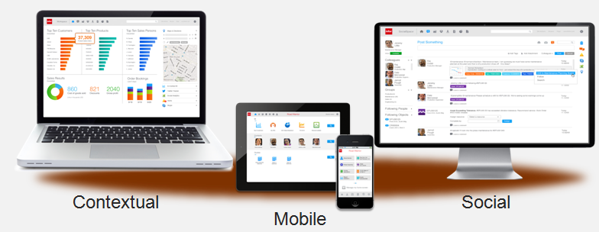
Changing the way work is done
Notes:
Infor has made the solution contextual at the point of action by providing a lot of in-context BI. By virtue of being HTML5 compliant, the solution can be used on any mobile platform, be it your smart phone or an Ipad. And of course, this is the first standard ERP solution, which provides a social collaboration platform to the users

Slide 15






A Complete Solution
Timely Information
Flexible Integration
Optimal Business Operations
Effective
Collaboration
Efficient
Processes
Location Flexibility
Lower TCO

Slide 16
Synopsis
We have precise solutions for your respective industry.
We figure out the strains in your industry.
Our innovative technology will accelerate your productivity and service.

Slide 17

Thank you
INDIA USA HONGKONG UAE THE NETHERLANDS SINGAPORE MALAYSIA

